Slide 1
Research Platform for Custom Memory Cube
Yu Zou
Vinayak Deshpande
Suvrat Tedia
MS students
Dr. Herman Lam
Assoc. Professor of ECE
University of Florida
Dr. Gongyu Wang
Dr. Alan George
Professor of ECE
University of Florida

Slide 2
Review & Overview
DRE* on Merlin board
Notional CMC** architecture
Explored design options (design options 1 – 5)
Implemented DRE prototypes on Merlin-board CMC platform
Design options 1, 2, & 3
SpMV app (using HT) with design options 1 and 3
Image differencing app (using HT) with design option 3
Performance measurement on Merlin board for CMC
Performance measurement on notional CMC architecture
Performance modeling of CMC arch. on Merlin board
Performance measurement
Challenges & solutions
Where are we now?
Where are we heading (CAW16)?
* DRE: Data rearrangement/reorder engine ** CMC Custom Memory Cube
Notes:
When we first started working on the Merlin board, we concentrated on the design and implementation of the data rearrangement engine (DRE) on the Merlin board. Implementation of DRE prototypes is interesting, but unless we can make useful performance measurement, the usefulness of the CMC platform is limited.

Slide 3
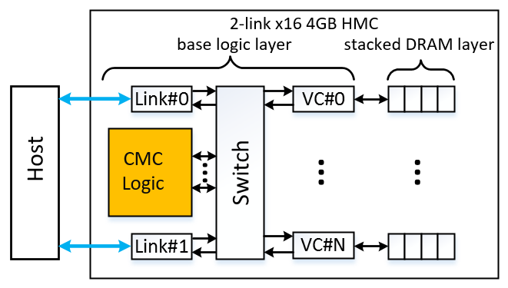
Notional CMC Architecture
Simplified view: an HMC with a user-programmable logic layer

Slide 4
DRE Prototype on CMC Architecture
VB3
VB4
View buffer (VB) can be set up inside the HMC (design option 3) or inside CMC logic (design option 4)

Slide 5
Review & Overview
DRE* on Merlin board
Notional CMC** architecture
Explore design options (design options 1 – 5)
DRE prototypes on Merlin-board CMC platform
Design options 1, 2, & 3
SpMV app (using HT) with design options 1 and 3
Image processing app (using HT) with design option 3
Performance measurement on Merlin board for CMC
Performance measurement on notional CMC architecture
Performance modeling of CMC arch. on Merlin board
Performance measurement
Challenges & solutions
Where are we now?
Where are we heading (CAW16)?
* DRE: Data rearrangement/reorder engine ** CMC Custom Memory Cube

Slide 6
Performance Measurement
Notional CMC architecture
Desired observation points
A: Host latency
B: CMC latency
C: CMC component delay
D: Latency of HMC internal data access
Local-vault and non-local-vault accesses cause different latencies
E: Latency of DRAM layer access
Inside vault, row buffer hit & row buffer miss will cause different latencies
T: Transfer delay
Depends on design option (where the view buffer is stored)
T
* Latency: delay from input into a point in the system to desired outcome

Slide 7
Mapping of Observation Points to Merlin Platform
latency A = latency B + delay T
latency B = latency B’ – delay F’minusD’
delay C = delay C’
latency D = latency D’
latency E = latency E’
delay T = some function of T’ (depends on design option)
T
T’
F’minusD’
Notes:
T is command + result data transfer back to host; depends on design options and where results are stored (HMC, DDR, FPGA fabric, etc)

Slide 8
Performance Measurement on Merlin Board
latency A = latency A’
latency B = latency B’ – delay F’minusD’
delay C = delay C’
latency D = latency D’
latency E = latency E’
delay T = some function of T’ (depends on design option)
T’
F’minusD’
A’ is measured in host code
B’, C’, F’ are measured in HT code (CMC logic)
T’ to be determined
Delay F’minusD’ = latency F’ – latency D’
If we cannot obtain D’ and E’ from Micron (or while waiting for NDA)
latency D’ = latency G’ – latency G’_D’ = latency G’ – (VirtualMC module latency + HMCC module latency + HMC link latency)
latency E’ cannot be measured; but may be determined using simulation tools

Slide 9
Approach for Challenge D’
F’minusD’
latency D’ = latency G’ – delay F’minusD’ = latency G’ – (VirtualMC module latency + HMCC module latency + HMC link latency)
Latency G’ (round-trip)
Collaborating with Convey to debug PERFMON code
VirtualMC module latency
Implemented as TLB (Translation Look-aside Buffer) in code
Non-deterministic
Will collaborate with Convey
HMCC module latency
Collaborating with Altera
T’

Slide 10
Approach for Challenge G’
PERFMON
PERFMON view of Merlin platform
Hardware monitor designed by Convey
Notes:
Pers_PERFMON and MC_PERFMON are verilog module names

Slide 11
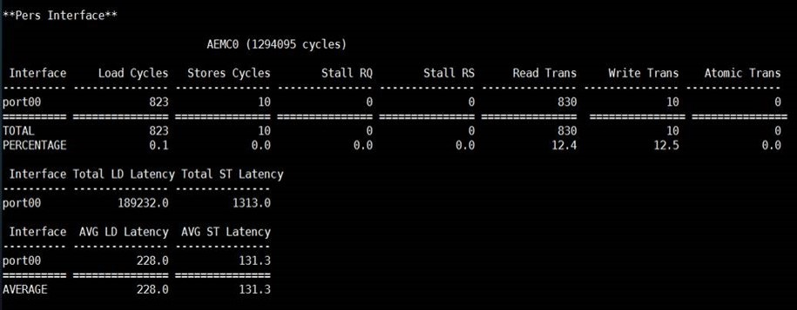
Approach for Challenge G’ (Contd.)
Roadblock
Total LD latency measured in PERFMON code (189,232 cycles) inconsistent with latency measured in app HT code (742 cycles)
Consulted with Convey: PERFMON code collects other memory accesses (including host, infrastructure) in addition to memory accesses from app (HT code)
Notes:
Results measured by PERFMON code not what we needed (not incorrect)

Slide 12
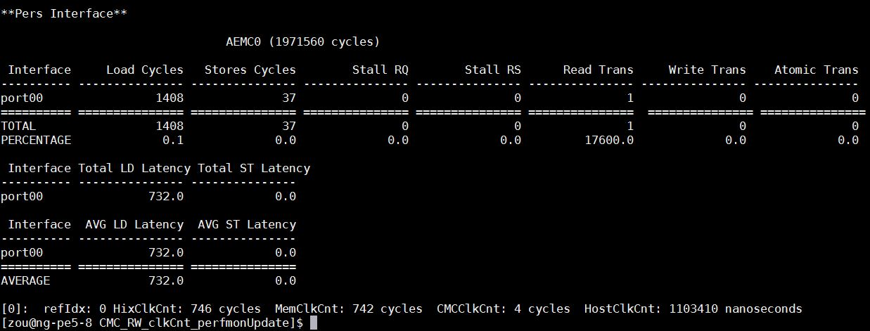
Approach for Challenge G’ (Contd.)
Solution
Found method to isolate memory accesses (modified PERFMON code)
Validated modification by comparing measured F’ (from PERFMON) against F’ measured in application HT code
Similarly, we can apply modification to measure G’
measured in modified PERFMON
measured in app (HT)
Notes:
Figures shows F’ measured in PERFMON is consistent with F’ measured in HT code
Now we have determined F’, in a similar manner, we can determine G’.

Slide 13
VirtualMC module latency
Will collaborate with Convey
How we currently understand problem (from analyzing infrastructure code):
TLB translates virtual memory addresses to physical addresses
Delay is not consistent (e.g., long delay can be caused by TLB miss)
Possible solutions:
Statistical model?
Increase page-table size to minimize TLB misses?
Notes:
TLB Translation Lookaside Buffer – a memory cache to translate virtual address to physical address

Slide 14
Benchmarking to Determine A, B, C, and F
F’minusD’
T’
A’ is measured in host code
B’, C’, F’ are measured in HT code (CMC logic)
latency D’ = latency G’ – latency G’_D’ = latency G’ – (VirtualMC module latency + HMCC module latency + HMC link latency)
latency E’ cannot be measured; but may be determined using simulation tools
Notes:
These are the observation points that we can currently measure.

Slide 15
Benchmarking Results: Single Mem. Rd/Wr
T’
Operations | A’ (ns) | B’ (cycles) | C’ (cycles) | F’ (cycles)
Single memory read | 1058559 | 168.4414 | 4 | 164.4414
Single memory write | 1057302 | 175.6587 | 4 | 171.6587
A’ measured inside host application using timers
B’, C’ and F’ are measured inside the HT code (CMC logic) using counters

Slide 16
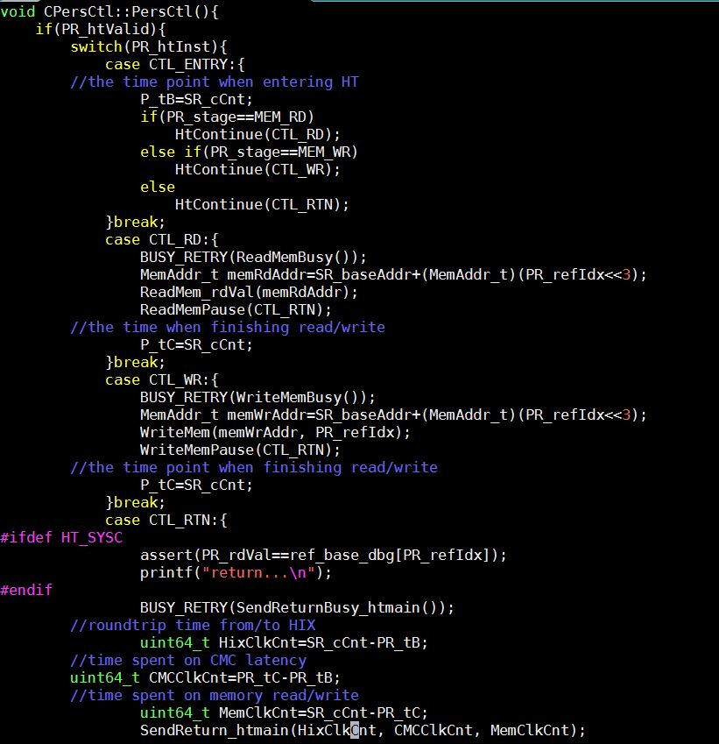
Measure B’
Operations | A’ (ns) | B’ (cycles) | C’ (cycles) | F’ (cycles)
Single memory read | 1058559 | 168.4414 | 4 | 164.4414
Single memory write | 1057302 | 175.6587 | 4 | 171.6587
starting time of B’
T’
ending time of B’
latency B’
B’ is measured in HT code
Starting point of CMC
Ending point of CMC

Slide 17
Measure C’
Operations | A’ (ns) | B’ (cycles) | C’ (cycles) | F’ (cycles)
Single memory read | 1058559 | 168.4414 | 4 | 164.4414
Single memory write | 1057302 | 175.6587 | 4 | 171.6587
starting time of B’ & C’
ending time of C’
T’
C’ is measured in HT code
Starting point of CMC logic
Ending point of CMC logic
latency C’

Slide 18
Measure F’
Operations | A’ (ns) | B’ (cycles) | C’ (cycles) | F’ (cycles)
Single memory read | 1058559 | 168.4414 | 4 | 164.4414
Single memory write | 1057302 | 175.6587 | 4 | 171.6587
ending time of C’;
starting time of F’
T’
F’ is measured in HT code
Point of issuing memory request
Point of receiving memory response
ending time of B’
latency F’

Slide 19
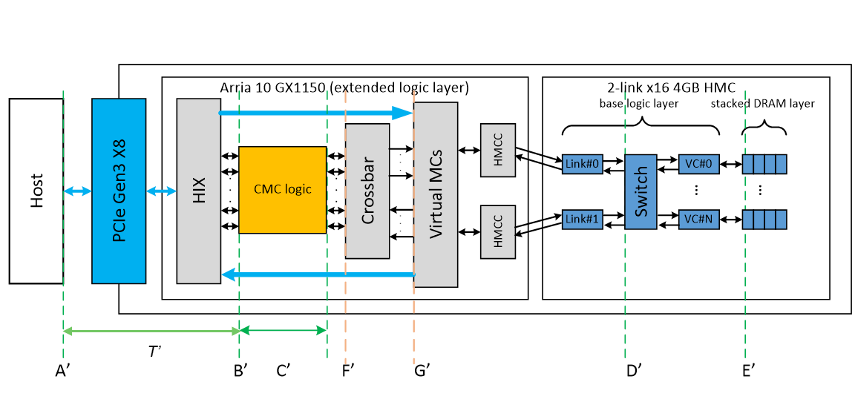
Going Forward (CAW16)
Complete performance measurement on Merlin board for single-memory operation
Finish measurement of latency HMCC, latency G’, latency F’_D’, latency VirtualMC
Map results to model of envisioned CMC architecture
Apply lessons learned to conduct experiments to measure DRE operations

